Slide 1
Food Wastage Management System
Presented By
GIC_OND21_FS_JAVA_5
Mahendra vuggumudi (gic1221015)
VeRTHIKA SHARMA (GIC1221008)
Yamini sirisala (gic1221007)
Mydhili ravichandran (gic1221018)

Slide 2
Introduction
Food Wastage is a massive problem in our society. In highly populated countries like India, food wastage is a disturbing issue.
The streets, garbage bins and landfills have sample proof to prove it. weddings, canteens, restaurants, social and family get-togethers and functions expel out so much food.
Food wastage is not only an indication of hunger or pollution, but also of many economic problems. The high standard of living has resulted in the wastage of food, clothes, etc. because of quick changes in habits and lifestyle. Instead of wasting these things we can put them in use by donating them to various organizations such as orphanages, old age homes, etc. Our aim is to help eradicate the hunger in today's world and provide food to every living individual.

Slide 3
Objective
The purpose of creating this Application is to eradicate hunger in the most possible way . NMFW is a real-time app which aims to reduce wastage of food.
In this app any person can register themselves as a user and either donate or receive food. Whenever a user donates food, it gets sorted in the real-time database.
Our aim is to help eradicate the hunger in today's world and provide food to every living individual.

Slide 4
List of Modules
Admin
Donor

Slide 5
Admin
Admin module allows system administrator to set up back-end of the system and perform basic system configuration, mainly definition of predefined drop-down fields, definition of classes time schedule, etc.

Slide 6
Software Interface
Front end: HTML, CSS ,JavaScript
Language: Java Spring Boot
Back End: MySQL

Slide 7
Hardware Interface
Processor: Intel Pentium4 2.00GHz or above
Memory: 512MB
Hard Disk Drive: 40MB or above

Slide 8
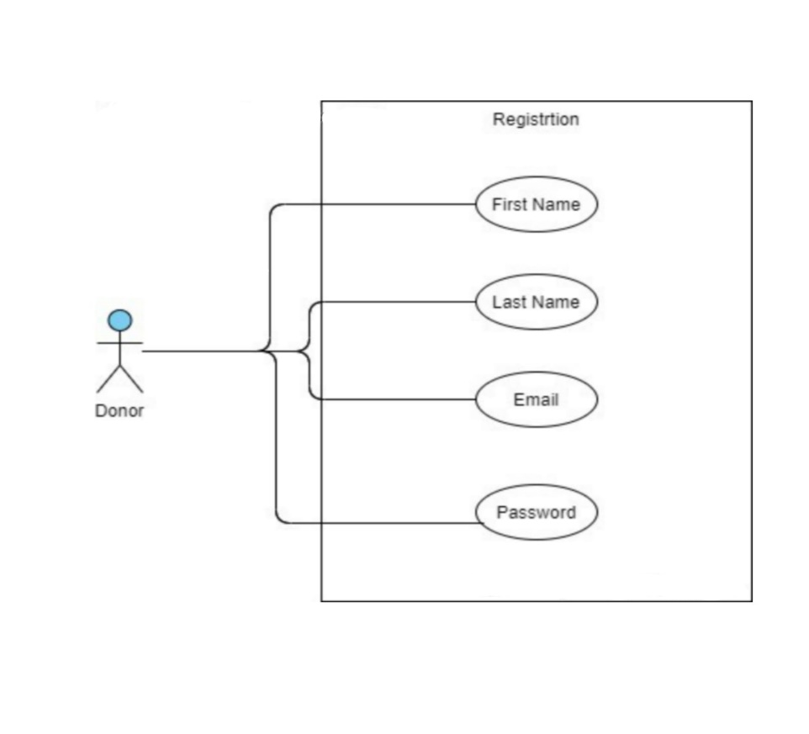
UseCase Diagrams
Registration

Slide 9
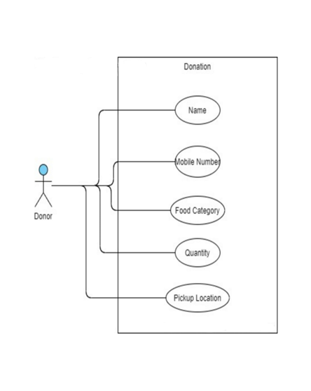
UseCase Diagrams

Slide 10
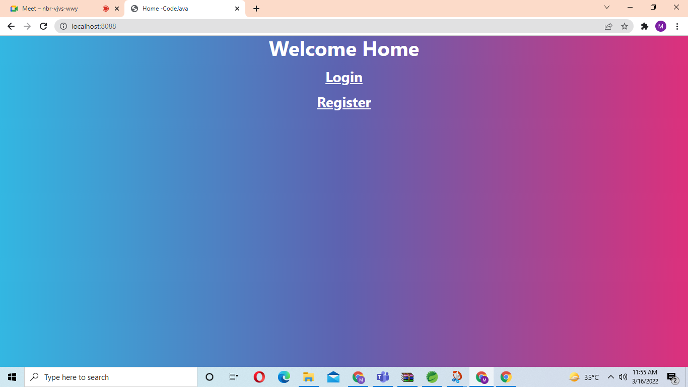
Login Page

Slide 11
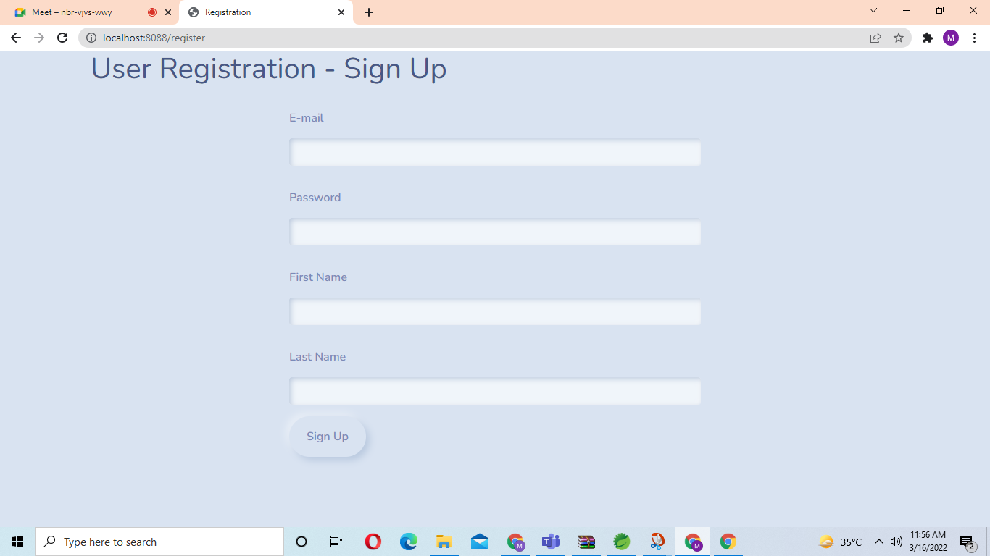
Registration Page

Slide 12
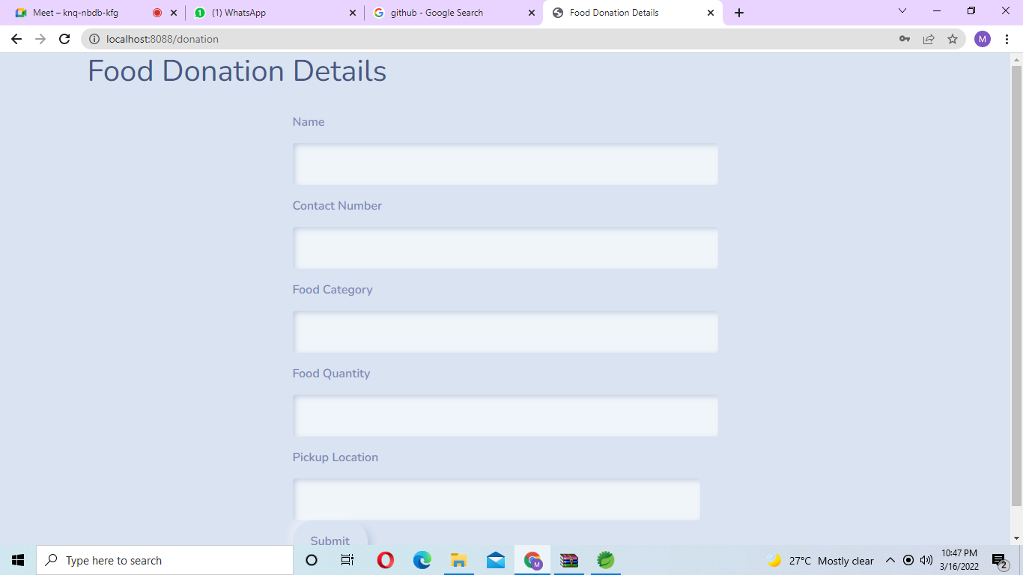
Food Donation Details

Slide 13
THANK YOU

